Slide 1

Mental Health in Tech
By Lidet Alemu & Charles Pryor

Slide 2

Agenda
Introduction
Goal
Methods
Analysis
Conclusion and Recommendations

Slide 3

Introduction
According to a 2020 research published by Open Sourcing Mental Illness (OSMI), people working in tech experience mental health issues at a higher rate (51%) than the general population.
The study attributes this to working long hours with little sleep, and with the competitive nature of the field.
If not treated, employee’s with mental illness is just as critical as physical health when it comes to productivity and effectiveness.
Source https://www.businessinsider.com/open-sourcing-mental-illness-stigma-tech-2019-12

Slide 4
Goals
Design a model that will determine if an employee’s mental health status will interfere with their job performance.
Identify specific workplace variables that forecast a “yes’ in mental health problems interfering with one’s work.
Recommend further studies on how to maximize workplace productivity for employees with mental health disorders.

Slide 5
Examples of Common Mental Disorders Under the Tech Umbrella
Depression
Adult ADD
Anxiety
Drug and Alcohol abuse
Isolation / Loneliness
Stress Management
Social Pressure

Slide 6

Data
Countries included
USA
Canada
UK
Gender
Male = 77%
Female = 21%
Queer = 1 %
Trans = 0.1%
Other = 0.1%
Company Size
25 & less = 36 %
26 to 100 = 23%
100 to 500 = 14%
500 to 1000 = 4%
1000 & above = 22%
Age
Average Age = 32
Min = 18
Max = 72

Slide 7
Questions asked
Have you sought treatment for a mental health condition?
Family History of mental illness
Does your company offer adequate Mental Health treatment plans
Are these plans known?
Ease of medical leave
Colleague sharing
Workplace Viewpoint

Slide 8
Strong Indicators of Work Interference
Those who previously received treatment for mental health conditions
Having a family history of mental illness
Having employers who do not provide resources to learn more about mental health issues and how to seek help
Not willing to discuss a mental health issue with direct supervisor(s)
The belief that employers do not take mental health issues as seriously as physical health
Identifying as male
Fear of taking medical leave for mental health conditions

Slide 9
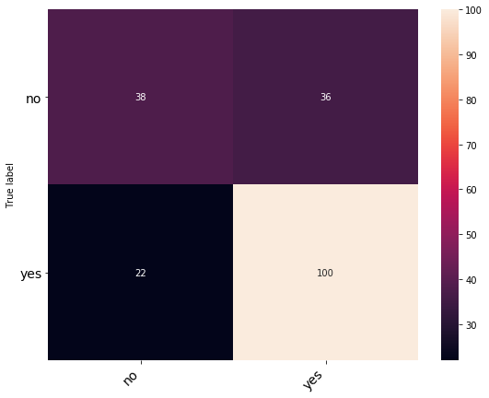
Model
70% Accuracy
Work interferes | Precision | Recall | F1 score
Yes | 0.63 | 0.51 | 0.57
No | 0.74 | 0.82 | 0.78
Predicted label
Notes:
# TP FP # p = predtru/total true
# FN TN

Slide 10

Conclusion and Recommendations
Mental health is just as critical as physical health when it comes to productivity and effectiveness.
We recommend companies Craft and promote policies that promote wellbeing.
Start talking about mental health
Provide resources that help employees better manage their well being,
Remote work options
Benefit packages that include preventative care for mental health

Slide 11

Next Steps ..
We want to explore the treatment feature of the data set.
We would like to explore the demographic categories in our “yes” classification set to optimize workplace barriers to performance to the target group.
Finally test which disorders are more common in which sub classification of tech, e.g. Cybersecurity, Software Engineering, Data Science!

Slide 12


